Slide 1
Developing Models on Alveo U200
Manuel Rios

Slide 2
GitHub Repository

Slide 3
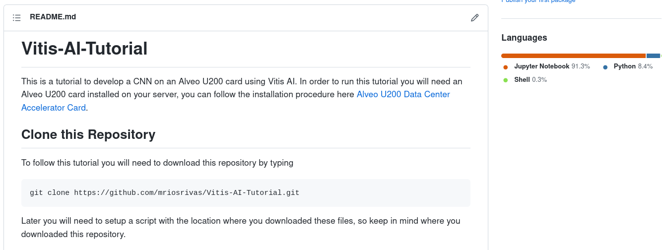
Clone GitHub Repository
You can download all the source material from here:
git clone https://github.com/mriosrivas/Vitis-AI-Tutorial.git

Slide 4
Alveo U200

Slide 5
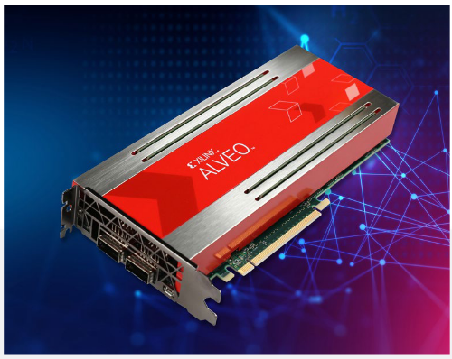
Alveo U200
Xilinx 16nm UltraScale™ architecture
Adaptable to any workload
Database Search & Analytics
Financial Computing
Machine Learning
Storage Compression
Video Processing/Transcoding
Genomics

Slide 6
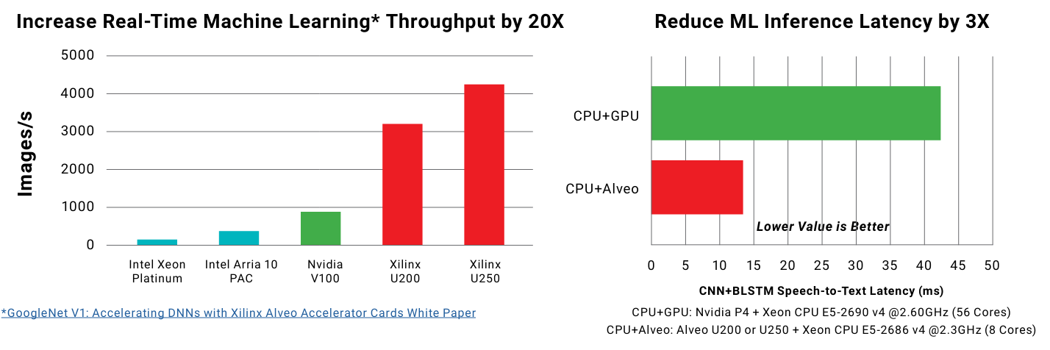
Alveo U200

Slide 7
Alveo U200 -DPUCADF8H
The Xilinx® Deep Learning Processor Unit (DPU) is a series of soft IP dedicated for convolutional neural networks acceleration.
DPUCADF8H is a high throughput CNN inference IP for Alveo cards.
The IP is optimized for high-resolution image networks and featured with high efficiency.
It runs with a set of efficiently optimized instructions and it can support most convolutional neural networks, such as VGG, ResNet, GoogLeNet, YOLO, SSD, MobileNet, and FPN.

Slide 8
Alveo U200 -DPUCADF8H
Highlights of DPUCADF8H functionality include:
○ Convolution, dilated convolution, and deconvolution
○ Maximum and average pooling
○ Element wise sum
○ ReLU
○ Data split and concat
○ Data reorganization
○ Fully connected layer
○ Batch normalization

Slide 9
Alveo U200 -DPUCADF8H
Highlights of DPUCADF8H functionality include:
○ Convolution, dilated convolution, and deconvolution
○ Maximum and average pooling
○ Element wise sum
○ ReLU
○ Data split and concat
○ Data reorganization
○ Fully connected layer
○ Batch normalization

Slide 10
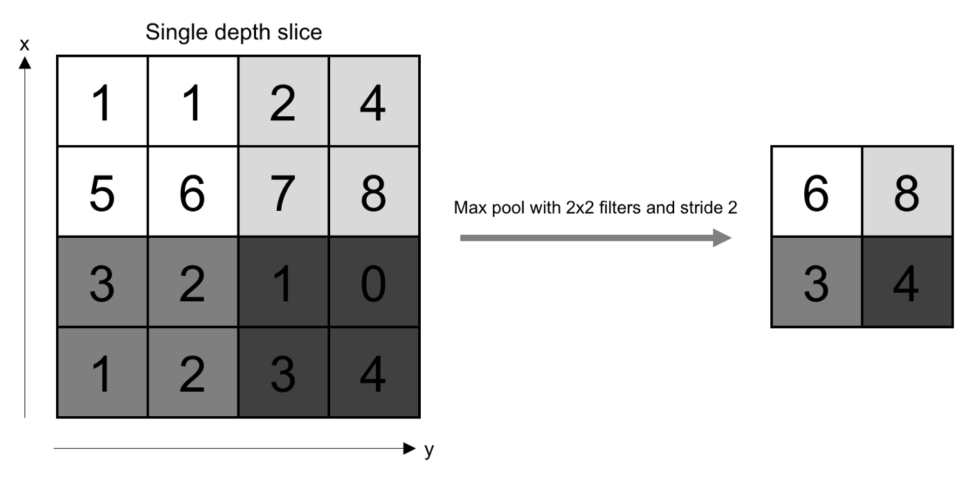
Alveo U200 -DPUCADF8H
Highlights of DPUCADF8H functionality include:
○ Convolution, dilated convolution, and deconvolution
○ Maximum and average pooling
○ Element wise sum
○ ReLU
○ Data split and concat
○ Data reorganization
○ Fully connected layer
○ Batch normalization

Slide 11
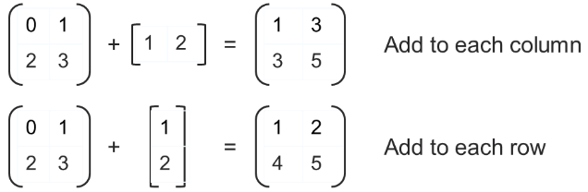
Alveo U200 -DPUCADF8H
Highlights of DPUCADF8H functionality include:
○ Convolution, dilated convolution, and deconvolution
○ Maximum and average pooling
○ Element wise sum
○ ReLU
○ Data split and concat
○ Data reorganization
○ Fully connected layer
○ Batch normalization

Slide 12
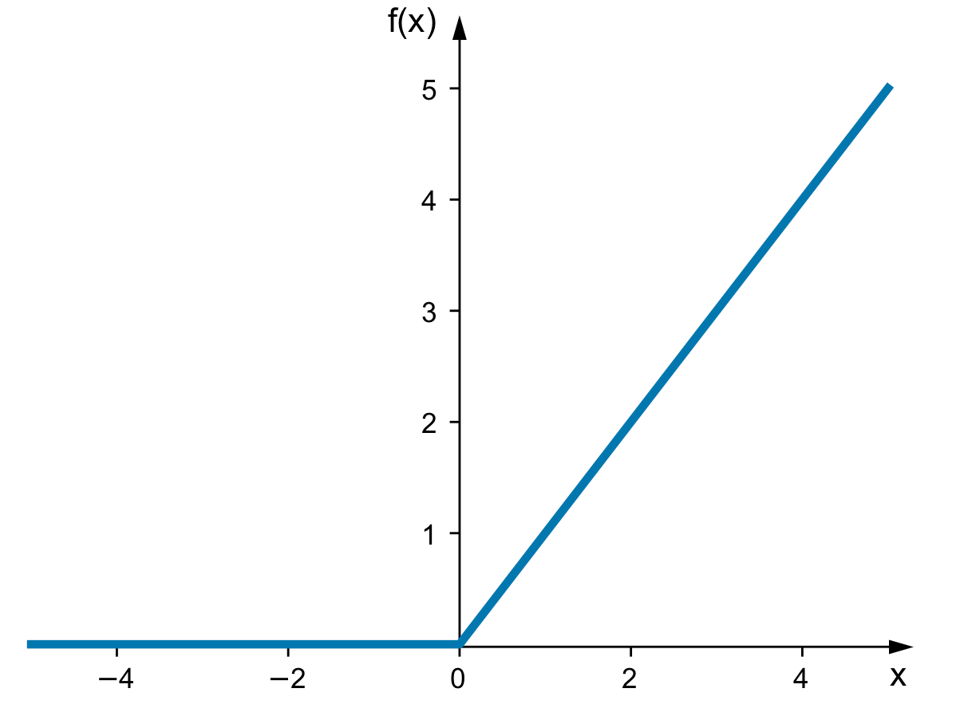
Alveo U200 -DPUCADF8H
Highlights of DPUCADF8H functionality include:
○ Convolution, dilated convolution, and deconvolution
○ Maximum and average pooling
○ Element wise sum
○ ReLU
○ Data split and concat
○ Data reorganization
○ Fully connected layer
○ Batch normalization

Slide 13
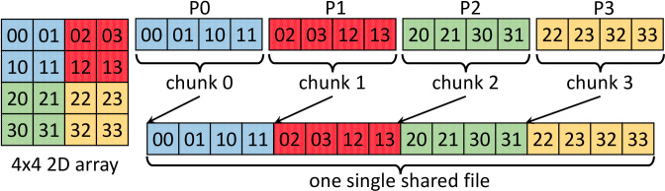
Alveo U200 -DPUCADF8H
Highlights of DPUCADF8H functionality include:
○ Convolution, dilated convolution, and deconvolution
○ Maximum and average pooling
○ Element wise sum
○ ReLU
○ Data split and concat
○ Data reorganization
○ Fully connected layer
○ Batch normalization

Slide 14
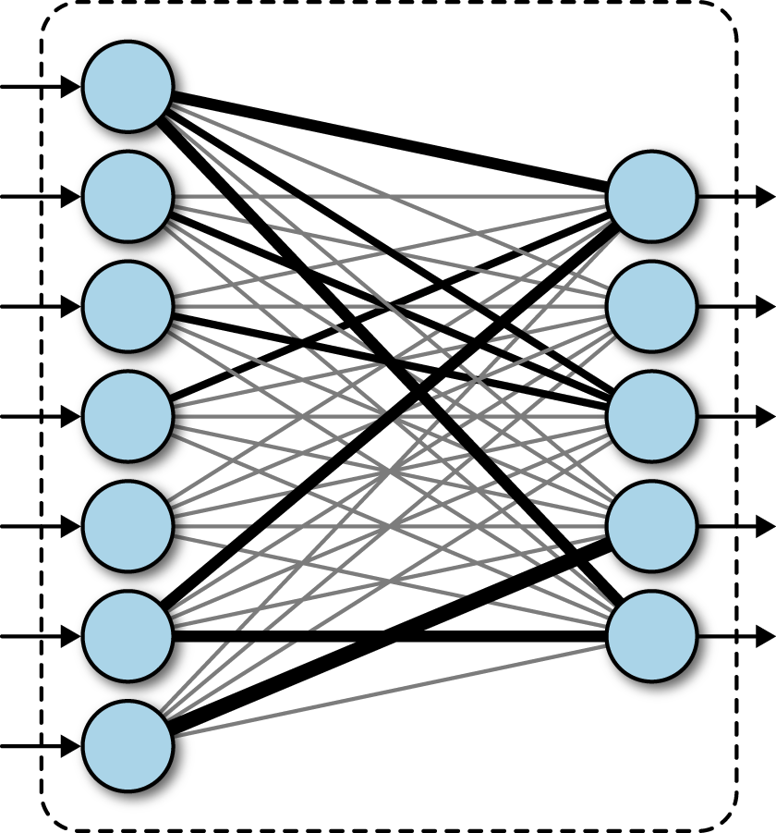
Alveo U200 -DPUCADF8H
Highlights of DPUCADF8H functionality include:
○ Convolution, dilated convolution, and deconvolution
○ Maximum and average pooling
○ Element wise sum
○ ReLU
○ Data split and concat
○ Data reorganization
○ Fully connected layer
○ Batch normalization

Slide 15
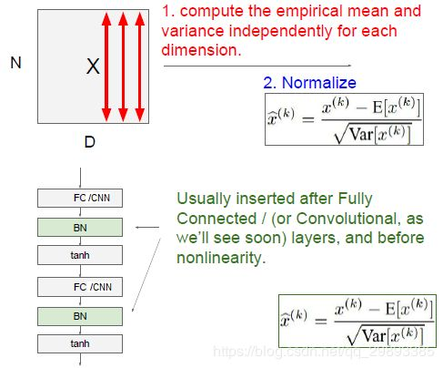
Alveo U200 -DPUCADF8H
Highlights of DPUCADF8H functionality include:
○ Convolution, dilated convolution, and deconvolution
○ Maximum and average pooling
○ Element wise sum
○ ReLU
○ Data split and concat
○ Data reorganization
○ Fully connected layer
○ Batch normalization

Slide 16
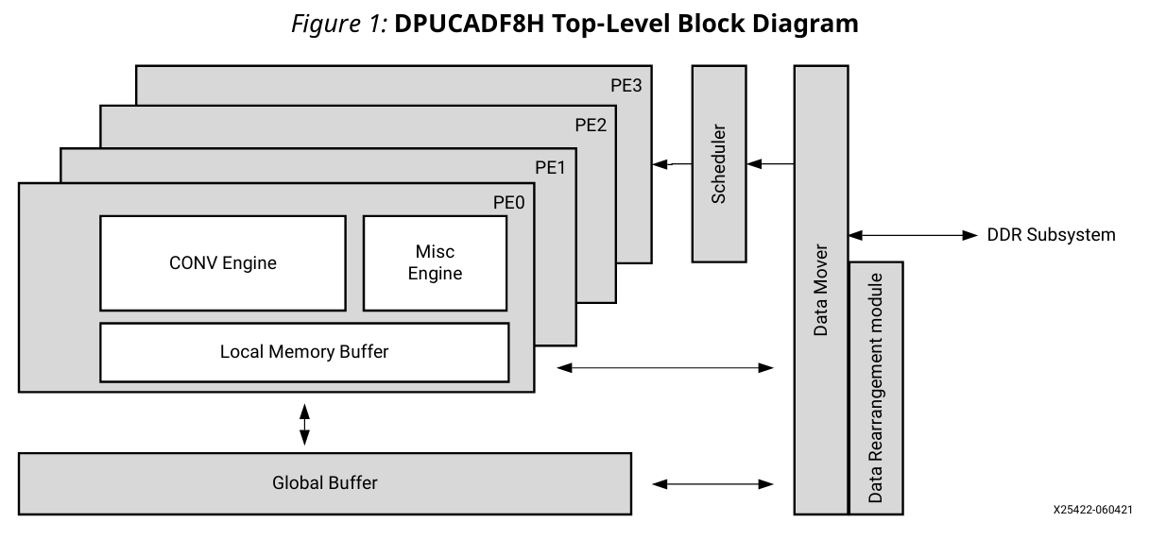
Alveo U200 -DPUCADF8H
Notes:
Four processing elements (PE):
• Throughput oriented and high-efficiency computing engines
• Wide range of convolution neural network support
• Optimized for high-resolution images.

Slide 17
Server Setup

Slide 18
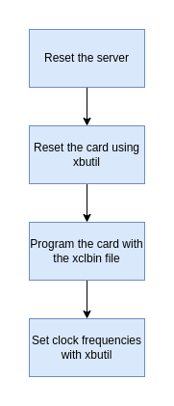
Frequency Setup of Alveo U200 Card
If we let the Alveo card to work with the default settings, it will overheat.
Temperature higher than 91°C will shutdown the card.
To solve this issue we change the clock frequency.

Slide 19
Frequency Setup of Alveo U200 Card
# Run this in the host machine (not in docker)
# Reset the card with id 0000:17:00.1
xbutil reset -d 0000:17:00.1
# Program the card with the xclbin file
xbutil program -d 0000:17:00.1 -u /opt/xilinx/overlaybins/DPUCADF8H/dpdpuv3_wrapper.hw.xilinx_u200_gen3x16_xdma_1_202110_1.xclbin
# Set the clock frequency
xbutil --legacy clock -d 0000:17:00.1 -f 70 -g 70

Slide 20
Vitis AI

Slide 21
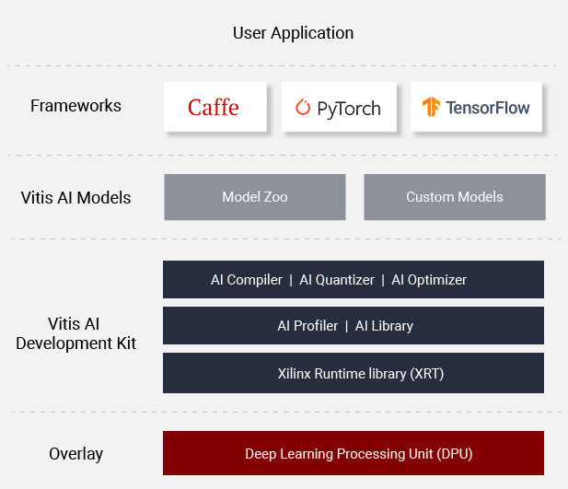

Vitis AI
Development stack for AI inference on Xilinx hardware platforms, including both edge devices and Alveo cards.

Slide 22
Setup Vitis AI
Clone Vitis AI repository
git clone --recurse-submodules https://github.com/Xilinx/Vitis-AI
cd Vitis-AI
Pull Docker image
docker pull xilinx/vitis-ai-cpu:latest
Note: These two steps are already done in the server.

Slide 23
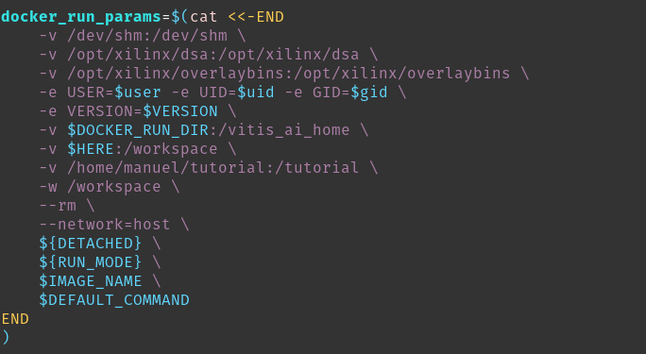
Setup Vitis AI
3. Edit docker_run.sh to add your project as a volume.

Slide 24
Run Docker and setup environment
Run your Docker container
cd Vitis-AI
./docker_run.sh
Activate the Tensorflow 2 environment
conda activate vitis-ai-tensorflow2
Source the Xilinx environment variables
source /workspace/setup/alveo/setup.sh DPUCADF8H

Slide 25
Workflow

Slide 26
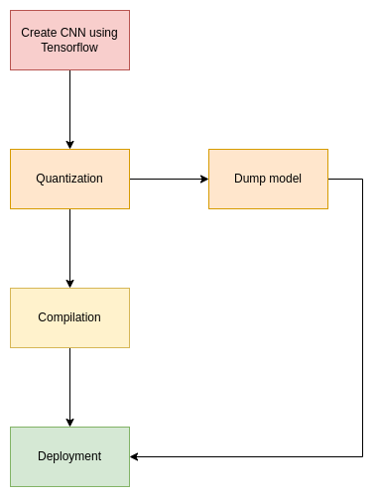
Workflow

Slide 27
Workflow
Local Machine
with GPU
Server with
Alveo Card

Slide 28
Workflow
We use a Jupyter Notebook to develop an h5 model.

Slide 29
Workflow
A script called quantize.py is used to transform our model into integer number precision.

Slide 30
Workflow
A script called dump.py will dump our simulation results for later comparison.

Slide 31
Workflow
A script called compile.sh is used to transform our quantized model into an xmodel for the DPU.

Slide 32
Workflow
A script called inference.py will perform inference using the developed model.

Slide 33
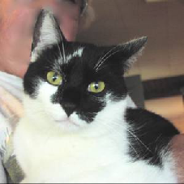
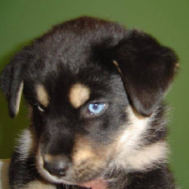
Create CNN Using Tensorflow
Create and train a cat-dog classifier.
Use Tensorflow 2.8.0 and Keras.
Save the model as an H5 file for later use.

Slide 34
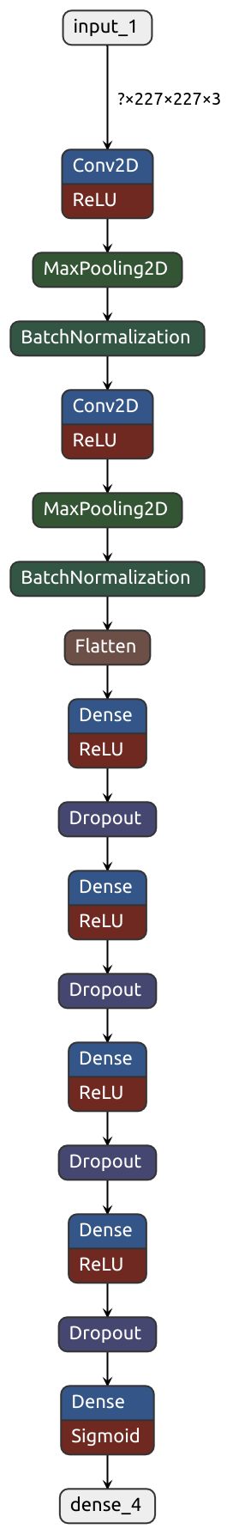
Create CNN Using Tensorflow
Basic architecture:
Convolutional Neural Network
Max Pooling
Batch Normalization
Dense Layers
Optimizer:
RMSprop
Loss:
Binary Cross Entropy
Metric:
Binary Accuracy

Slide 35
Create CNN Using Tensorflow
Basic architecture:
Convolutional Neural Network
Max Pooling
Batch Normalization
Dense Layers
Optimizer:
RMSprop
Loss:
Binary Cross Entropy
Metric:
Binary Accuracy

Slide 36

Create CNN Using Tensorflow
Basic architecture:
Convolutional Neural Network
Max Pooling
Batch Normalization
Dense Layers
Optimizer:
RMSprop
Loss:
Binary Cross Entropy
Metric:
Binary Accuracy

Slide 37
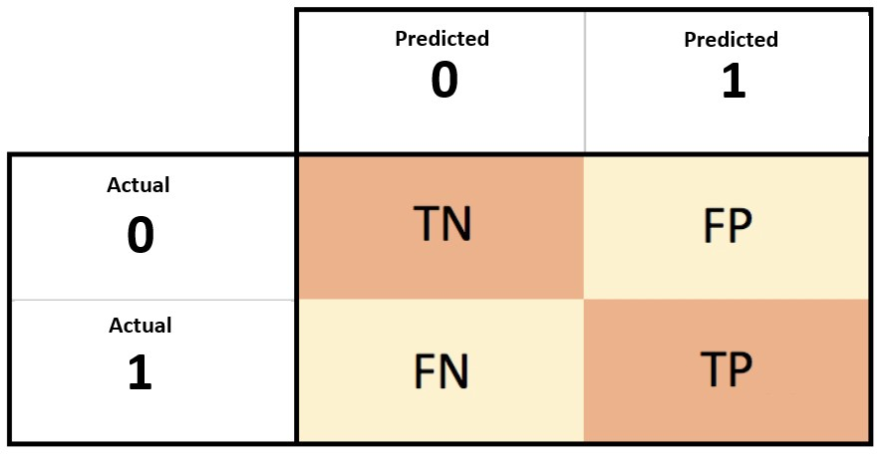
Create CNN Using Tensorflow
Basic architecture:
Convolutional Neural Network
Max Pooling
Batch Normalization
Dense Layers
Optimizer:
RMSprop
Loss:
Binary Cross Entropy
Metric:
Binary Accuracy

Slide 38
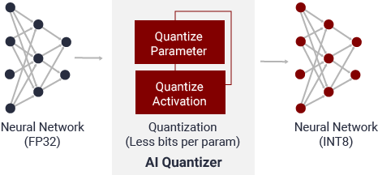
2. Quantize model
Quantization is the process of converting a 32-bit floating point model into an INT8 representation.

Slide 39
2. Quantize model
There are two different approaches to quantize a deep learning model:
Post-training quantization (PTQ)
Convert a pre-trained float model into a quantized model with little degradation in model accuracy.
A representative dataset is needed to run a few batches of inference on the float model.
Quantization aware training (QAT)
Models the quantization errors in both the forward and backward passes during model quantization.

Slide 40
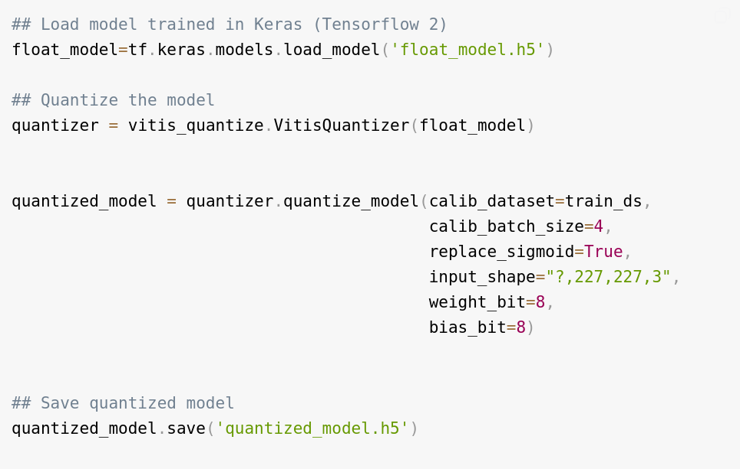
2. Post-training quantization (PTQ)

Slide 41
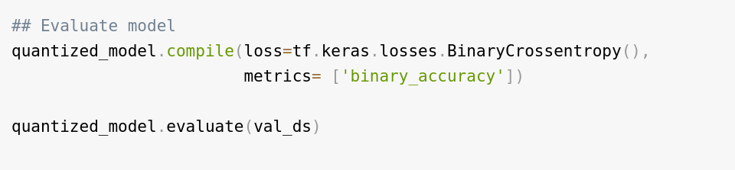
2. Post-training quantization (PTQ)

Slide 42
3. Dump Model
When deploying a model, debugging becomes difficult, therefore dumping the simulation results can help.
Dumping results can be:
Inputs and outputs
Weights and bias
Results can be integer and floating point for reference.

Slide 43
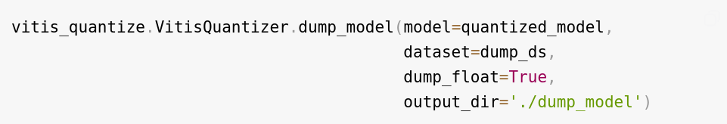
3. Dump Model

Slide 44
3. Dump Model
env XLNX_ENABLE_DUMP=1 XLNX_ENABLE_DEBUG_MODE=1 XLNX_GOLDEN_DIR=../quantization/dump_model/dump_results_0 \
xdputil run -i 1 ../compilation/compiled_model/deploy.xmodel \
../quantization/dump_model/dump_results_0/input_1_float.bin \
2>result.log 1>&2

Slide 45
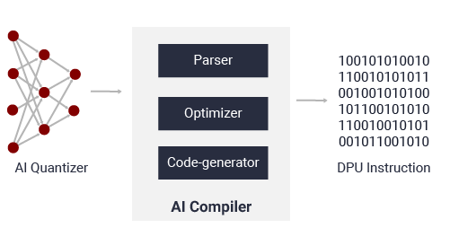
4. Compile model
Vitis™ AI compiler (VAI_C):
Interface to a compiler family targeting the optimization of neural-network computations to different DPUs.
Maps a network model to a highly optimized DPU instruction sequence.

Slide 46
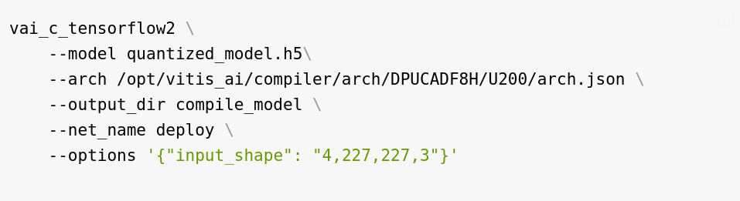
4. Compile model

Slide 47
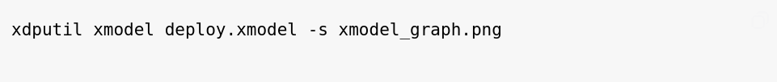
4. Compile model
We can plot the model graph using

Slide 48
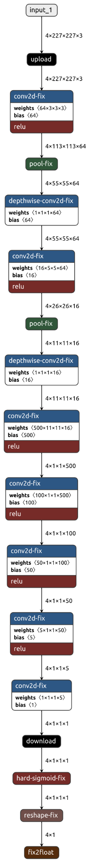
5. Deployment: Graph

Slide 49
5. Deployment: Sub-Graphs
Graph 0

Slide 50
5. Deployment: Sub-Graphs
Graph 0
Graph 2

Slide 51
5. Deployment: Sub-Graphs
Graph 0
Graph 1
Graph 2

Slide 52
5. Deployment: Sub-Graphs
CPU
Task
DPU
Task
CPU
Task

Slide 53
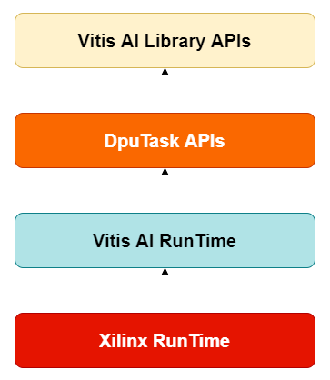
5. Deployment: API Levels

Slide 54
5. Deployment: API Levels
Host machine

Slide 55
5. Deployment: API Levels
When creating a complete new model
Host machine

Slide 56
5. Deployment: API Levels
When creating a complete new model (no preprocess needed)
When creating a complete new model
Host machine

Slide 57
5. Deployment: API Levels
For models already available on Vitis AI
When creating a complete new model (no preprocess needed)
When creating a complete new model
Host machine

Slide 58
5. Deployment: API Levels
For models already available on Vitis AI
When creating a complete new model (no preprocess needed)
When creating a complete new model
We will work at this level
Host machine

Slide 59
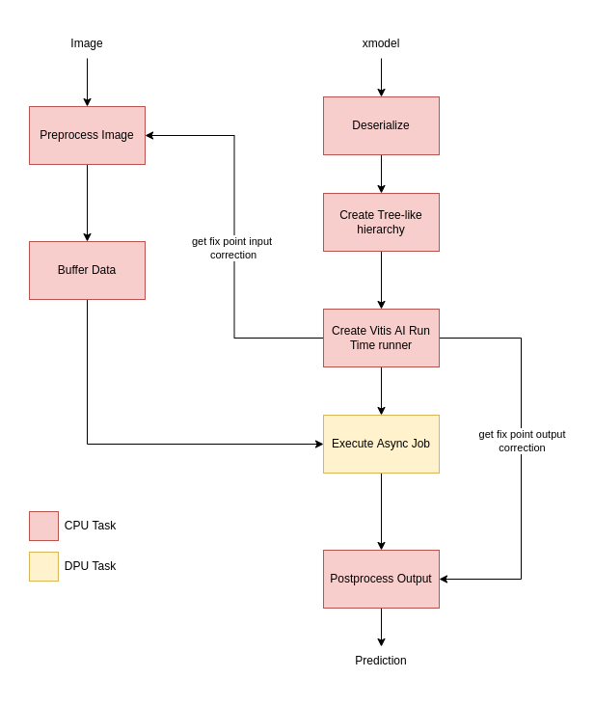
5. Deployment: Application

Slide 60
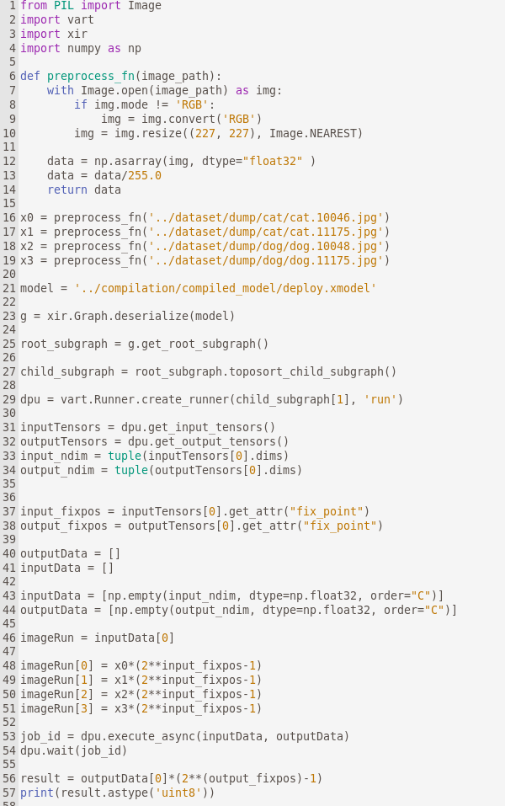
5. Deployment: Application

Slide 61
5. Deployment: Application

Slide 62
5. Deployment: Application

Slide 63
5. Deployment: Application

Slide 64
5. Deployment: Application

Slide 65
5. Deployment: Application

Slide 66
5. Deployment: Application

Slide 67
5. Deployment: Application

Slide 68
5. Deployment: Complete Application
To run a complete implementation
cd /tutorial/inference
python inference.py -d ../dataset/test -t 1 -m ../compilation/compiled_model/deploy.xmodel

Slide 69
6. Accuracy Check
To check your model implementation accuracy run
cd /tutorial/inference
python accuracy_calc.py

Slide 70
Thank you!

